Slide 1
Research Design and Analysis

Slide 2
Research Design
Groups by Treatment (Independent Variable)
Data Gathering Events (Dependent Variable)

Slide 3
Did direct instruction improve students’ ability to recall math facts?
Independent ⇓
Data Gathering
Pre-Test
Post-Test
DI to 4th Grade Class
group data
group data
t-test, paired if possible

Slide 4
Do students who receive DI achieve better than those who do not?
Independent ⇓
Data Gathering
Test
DI to 4th Grade Class
group data
Non-DI to different 4th Grade Class
group data
t-test, independent samples

Slide 5
Do students who receive DI for math facts retain learning over the summer?
Independent ⇓
Data Gathering
Pre-Test
Post-Test
Post-Post-Test
DI to 4th Grade Class
group data
group data
group data
Repeated Measures

Slide 6
Which instructional strategy works better for teaching math facts?
Independent ⇓
Data Gathering
Test
DI
group data
Cooperative
group data
Inquiry
group data
Single Factor

Slide 7
Multiple Tests Simultaneously
When multiple (more than two) groups are to be compared on the same measure it is not appropriate to test each pair separately. The comparisons are not independent. (Type I error)
Analysis of Variance ANOVA
An ANOVA only tells if significant differences exist between at least two groups. It does not tell which group pairs are significant. A post hoc analysis is necessary to figure out which group differences are significant.

Slide 8
Download OWM Data from the site

Slide 9
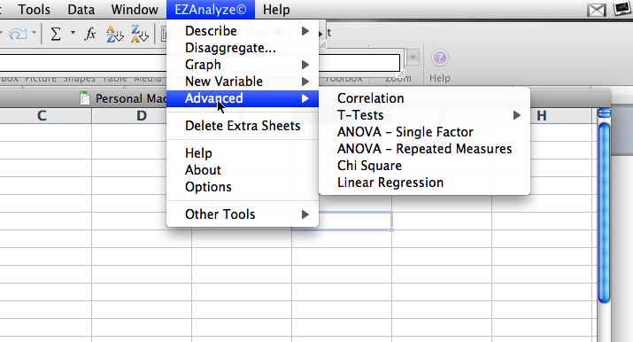
ANOVA in EZAnalyze
Single factor compares different groups on a single measure.
Repeated measures compares a single group on multiple uses of a single measure.

Slide 10
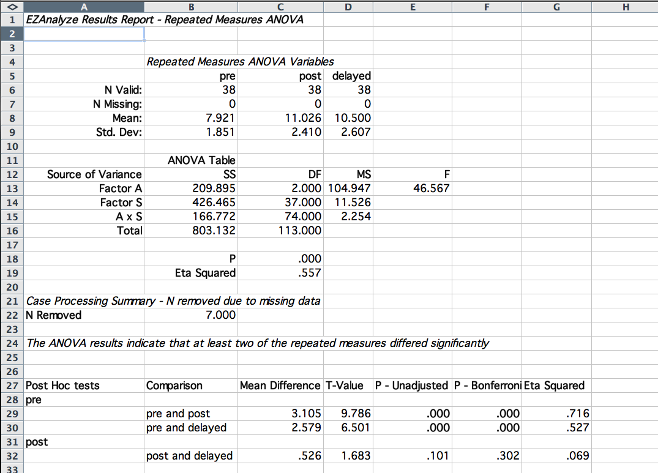
Significance of the whole ANOVA

Slide 11
ANOVA Post Hoc Tests
Use a Tukey HSD (honestly significant difference) to compute multiple mean differences.
Accurate with groups of equal size.
Conservative with unequal variance.

Slide 12
Post hoc test results

Slide 13
APA ANOVA Table

Slide 14
Descriptive Paragraph
Pretest, posttest, and 2 month delayed assessment scores for 38 students were compared using repeated measures ANOVA analysis (Table 1). Post and delayed scores were statistically significantly higher than pretest scores (p < .001). No statistically significant difference appeared between posttest and delayed scores.

Slide 15
Things to remember…
You have to figure out which t-test to use by judging the similarity of the groups.
Decide if your comparison should be one-tailed or two.
If you are comparing more than two groups simultaneously you have to use an ANOVA not a t-test.
Compute effect sizes, particularly if the groups are large.
Be random when you can.

Slide 16
Confounding Variations
Random Selection

Slide 17
Random Sample
The assumption of the sampling distribution of the mean is based on randomly selected groups of a given size.
So, to believe our sample is going to be one of those random selected groups, the sample has to be selected randomly.

Slide 18
Random Selection
With random sampling all members of the population to which you wish to generalize have an equal chance of being in the sample.
Scientific studies use true random sampling which is also called probability sampling.
Simple
Stratified (divide into subgroups then random)
Cluster sampling (randomly select subgroups as individuals)
If your sample is random you have to carefully explain how you made it that way. (methods section)

Slide 20
Simple Random Sampling

Slide 21
Men
Women
Stratified Random Sampling

Slide 22
Cluster Random Sampling

Slide 23
Random Selection
When all of the members of a population do not have an equal chance of being in the sample it is called nonprobablity sampling.
Quota sampling (random until a quota is filled)
Purposive sampling (random within subgroup)
Samples of convenience
Snowball sampling
If the sample is not random then you have to work hard at showing that your sample is not potentially dissimilar from the population. (methods section)

Slide 24
Quota Sampling

Slide 25
Purposive Sampling

Slide 26
Sample of Convenience

Slide 27
Snowball Sampling

Slide 28
Random Error
Random normal variation in groups.
Outside of the researchers control.
Inferential statistics deals with random error really well.
That is one of the reasons why groups should be formed randomly.

Slide 29
Dealing with Non-Random Samples
Carefully explain how the sample was formed in the methods section.
Carefully describe important elements of the context of the study that support the idea (or not) that the sample is like the population.
Carefully explain how the analysis of data will be done.
List the possible effect of sampling procedures in the limitations section of the conclusions.

Slide 30
Excel
The random function
Open the file called Names

Slide 31
Confounding Variations
Sample Size and Practical Significance

Slide 32
Standard Error of the Mean
n=1000
n=100
n=30
Population Distribution
For any distribution the larger the sample size the smaller the numerical standard error.

Slide 33
Standard Error of the Mean
n=1000
n=100
n=30
Population Distribution
1 standard deviation

Slide 34
Standard Error of the Mean
n=1000
n=100
n=30
Population Distribution
1 standard deviation

Slide 35
Standard Error of the Mean
n=1000
n=100
n=30
Population Distribution
1 standard deviation

Slide 36
Standard Error of the Mean
n=1000
n=100
n=30
Population Distribution
1 standard deviation

Slide 37
Effect Size (Practical Significance)
With large samples it is possible that significant differences will appear from very small mean differences.
When statistical significance appears, practical significance can be reported by showing the mean differences in units of standard deviation—not standard error (remember z scores).
The simplest calculation of effect size is to determine the distance between the two mean scores and divide by the average standard deviation. (Cohen’s d)

Slide 38
Effect Size—Practical Significance
How many standard deviations is the new mean from the first mean? Effect size of .2 is weak; .5 is moderate; .8 is strong

Slide 39
Practical Significance The difference of the means in units of standard deviation
T
ab
l
e 1
M
ean S
c
ore
s
on Johnson P
r
ob
l
em So
lv
ing
I
nven
t
or
y
f
or
S
t
uden
t
s
W
it
h
and
Wit
hou
t
Con
fli
c
t
Re
s
o
l
u
t
ion
T
ra
i
n
i
ng
.
Pre-Test
Post-Test
N
=
36
N
=
36
M
e
an
74
.
61
82
.
61*
S
D
13.35
11.85
*
=
p
<
.0
1
Difference in means: 74.61 - 82.61= -8
Average standard deviation: (13.35 + 11.85)/2 = 12.6
Practical significance: -8/12.6 = -.63

Slide 40
Practical Significance The difference of the means in units of standard deviation
T
ab
l
e 1
M
ean S
c
ore
s
on Johnson P
r
ob
l
em So
lv
ing
I
nven
t
or
y
f
or
S
t
uden
t
s
W
it
h
and
Wit
hou
t
Con
fli
c
t
Re
s
o
l
u
t
ion
T
ra
i
n
i
ng
.
Only report practical significance if the mean differences are statistically significant to begin with.
Pre-Test
Post-Test
N
=
36
N
=
36
M
e
an
74
.
61
82
.
61*
S
D
13.35
11.85
*
=
p
<
.0
1
Difference in means: 74.61 - 82.61= -8
Average standard deviation: (13.35 + 11.85)/2 = 12.6
Practical significance: -8/12.6 = -.63

Slide 41
Effect Size
Compute the effect size in the Pinecrest College data: Language score by gender

Slide 42
Confounding Variations
Anticipating the direction of the change in mean scores

Slide 43
Direction
Anticipated Mean Shift
5% (.05)
In some cases it can be assumed that the difference between means
scores will represent a positive shift. When we give a lesson
we expect that the test scores will rise from pretest to posttest.

Slide 44
Direction
Anticipated Mean Shift
5% (.05)
In some cases it can be assumed that the difference between means
scores will represent a negative shift. If we do conflict management
training we would anticipate that the number of conflicts
would be reduced.

Slide 45
Direction
alpha = .10
?
5% (.05)
5% (.05)
What happens if you cannot anticipate which way the mean will shift?
Will canceling inter-mural sports affect achievement positively or negatively?

Slide 46
Direction
alpha = .05
?
2.5%
(.025)
2.5%
(.025)
The possible means which would be considered significant must be
split to both ends of the sampling distribution—a two-tailed test
of significance. It is the researchers job to demonstrate that a
significance test should be one-tailed or two-tailed.

Slide 47
EZAnalyze Results Report - Paired T-Test of Pretest with Posttest
 |  | Pretest | Posttest
 | Mean: | 74.611 | 82.611
 | Std. Dev.: | 13.349 | 11.850
 | N Pairs: | 36
 | Mean Difference: | -8.000
 | SE of Diff.: | 2.936
 | Eta Squared: | .171
 | T-Score: | 2.724
 | P: | .010
EZAnalyze always reports two-tailed results
To compute one-tailed results divide p value in half.

Slide 48
Direction
alpha = .05
?
5% (.05)
2.5%
(.025)
2.5%
(.025)
It is easier to show significant differences (shorter distance from the mean) for one-tailed tests.

Slide 49
Direction
alpha = .05
?
5% (.05)
2.5%
(.025)
2.5%
(.025)
It is more difficult to show significant differences (longer distance from the mean) for two-tailed tests.

Slide 50
Pacific Crest—Fall Math by Gender
Logically should the teacher use a one-tailed or a two-tailed test?
What difference does it make?
EZAnalyze Results Report - Independent T-Test of group 1 and 2 on MathF
 | Gender | 1 | 2
 | Mean: | 40.215 | 51.533
 | Std. Dev: | 14.566 | 15.518
 | N: | 13 | 12
 | Mean Difference: | 11.318
 | T-Score: | 1.881
 | Eta Squared: | .124
 | P: | .073

Slide 51
In the language of hypothesis testing…
I hypothesize that there is a difference in math scores by gender.
Null hypothesis: there will be no difference between the scores by gender.
Since I cannot anticipate which way the scores will be different, I will use a two-tailed test.
I cannot reject the null hypothesis.
The best explanation, for now, is that both groups represent the same population.

